Slide 1
Lecture 10
Olap cube bottom-up approach

Slide 2
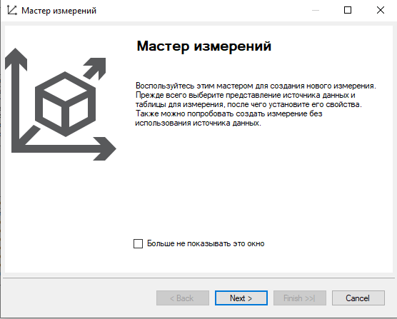
Creating new dimensions

Slide 3
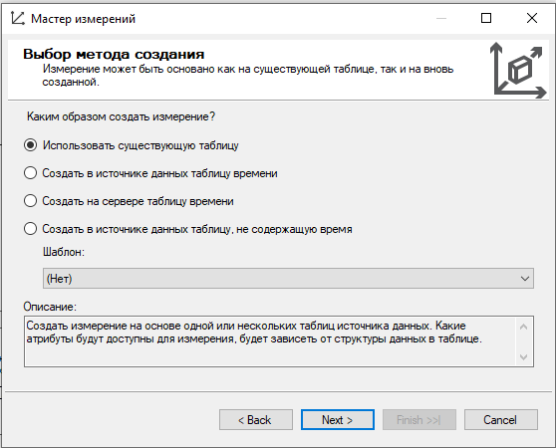
Use an existing table

Slide 4
Data scheme
We need to choose an existing scheme

Slide 5
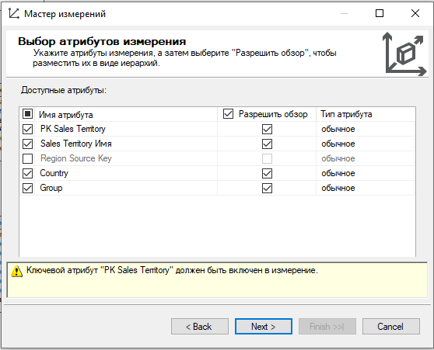
Dimension attributes

Slide 6
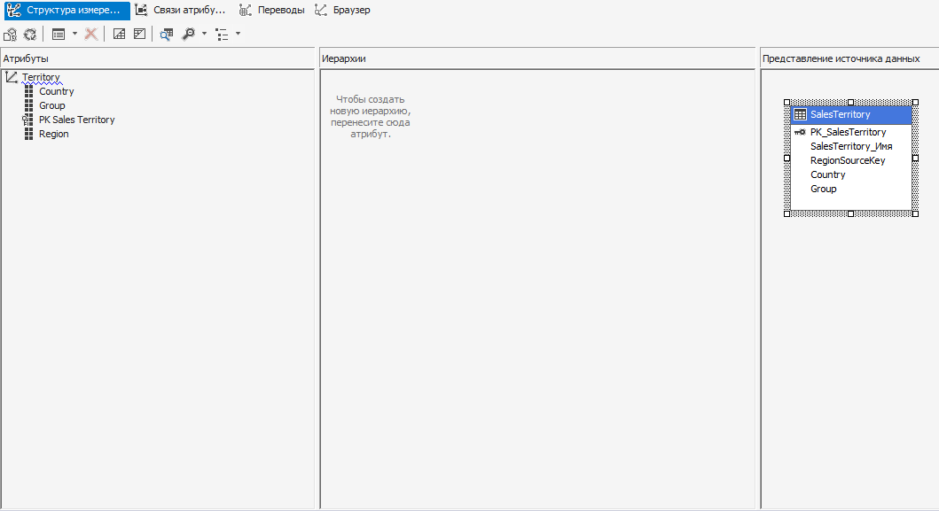
Dimension attributes

Slide 7
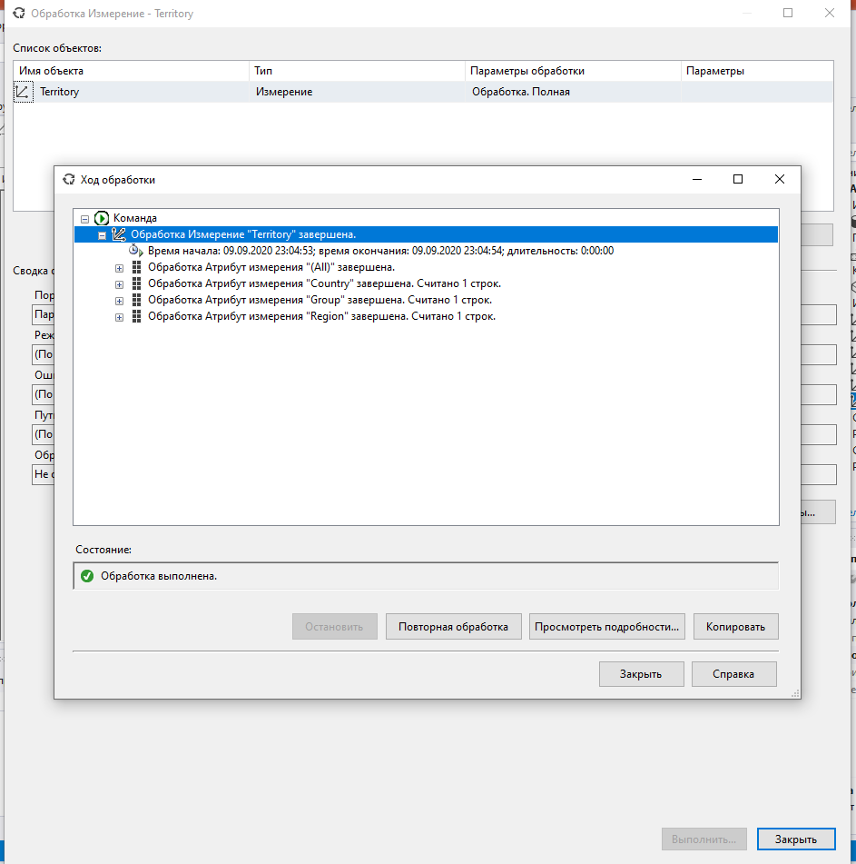
Deploying the dimension

Slide 8
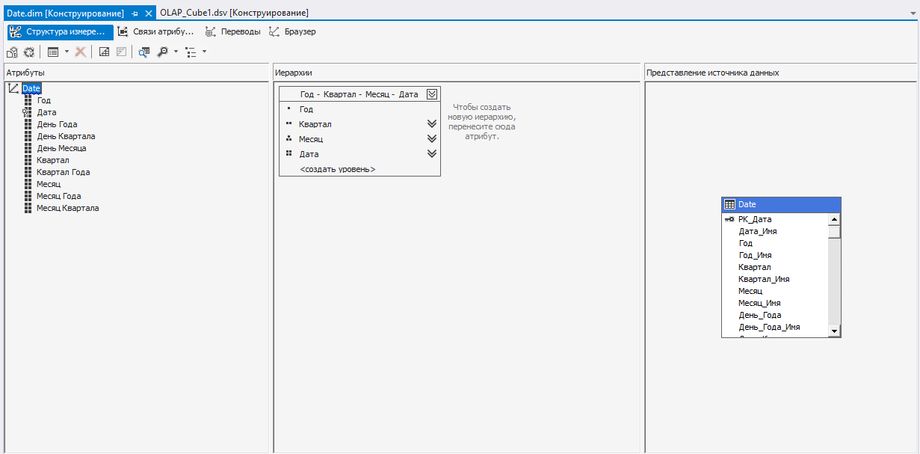
Building hierarchies

